Slide 1
Wireless Networking:
OFDM and Modulation
CS 655: Wireless and Mobile Computing
Parth H. Pathak

Slide 2
802.11 PHY and MAC
MAC:
CSMA/CA and wideband medium access
 | 802.11b | 802.11a | 802.11g | 802.11n | 802.11ac
Frequency | 2.4 GHz | 5 GHz | 2.4 GHz | 2.4/5 GHz | 5 GHz
Channel width | 20 MHz | 20 MHz | 20 MHz | 20/40 MHz | 20/40/80/160 MHz
PHY | DSSS/CCK | OFDM | OFDM, DSSS/CCK | OFDM | OFDM
MIMO & beamforming | No | No | No | Yes | Yes
Max. data rate | 11 Mbps | 54 Mbps | 54 Mbps | 600 Mbps | ~6933 Mbps
PHY-I:
OFDM and modulation
PHY-II:
MIMO and beamforming

Slide 3
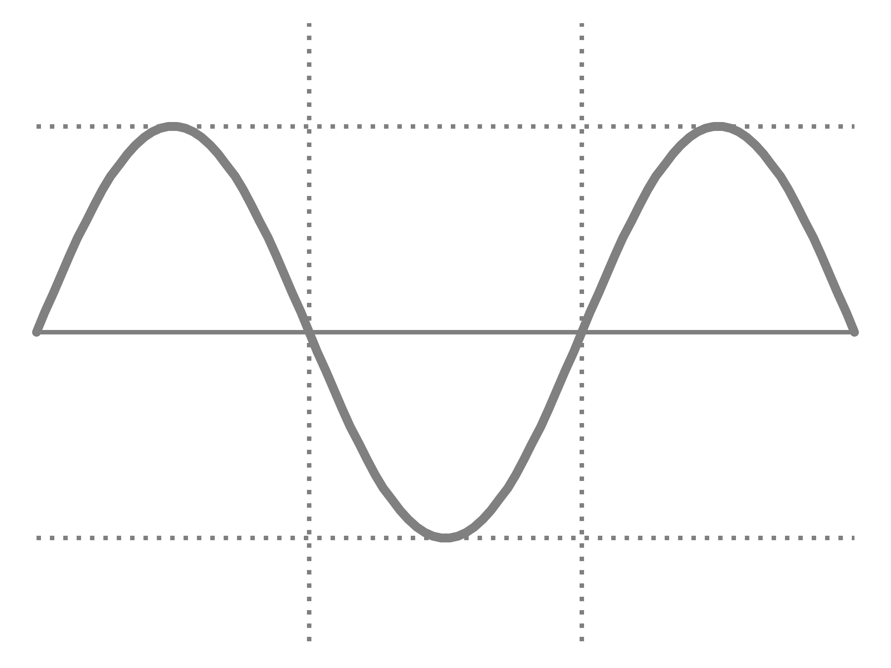


Wireless communication primer
Sine wave
Frequency, amplitude and phase
WiFi
f = 20 MHz
$$A Sin (2πft+ φ)$$
Amplitude
f = 1 Hz
A = 1
1
$φ$= 0
0
-1
Time (t)
0
0.5
1
1.5
2

Slide 4

Modulation
Use the RF signal to represent bits
Amplitude, frequency and/or phase can be modulated
$$A Sin (2πft+ φ)$$
Amplitude
Phase
Frequency

Slide 5
Modulation
Bit 0
Bit 1
1
0.5
Amplitude
Modulation
0
-0.5
-1
Time (t)
Bit 0
Bit 1
1
Frequency
Modulation
0.5
0
-0.5
-1
Time (t)

Slide 6

Phase modulation
Binary Phase Shift Keying
Bit 1: phase $π$, Bit 0: phase 0
Differential BPSK
Bit 0 : no change in phase compared to previous bit
Bit 1 : phase changes by $π$ compared to previous bit
0
1
0
BPSK
0
1
0
Differential PSK

Slide 7




Phase modulation
Polar representation of phase shift keying schemes
01
00
$$\frac{3π}{4}$$
$$\frac{π}{4}$$
1
0
$$\frac{5π}{4}$$
$$\frac{7π}{4}$$
11
10
BPSK
Quadrature PSK (QPSK)

Slide 8
QAM modulation schemes
Quadrature Amplitude and Phase Modulation (QAM)
Modulates both phase and amplitude of the signal
Commonly used in wired and wireless communications
Most current 802.11 standards utilize QAM of different orders
Also used in Long Term Evolution (LTE) 4G cellular networks

Slide 9

I/Q representation
Instantaneous state of a sine wave can be represented using polar coordinate system
Amplitude
$$φ (phase)$$

Slide 10






I/Q representation
The polar representation is referred as I/Q data representation
$$Q Axis$$
$$I\left(t\right)=A\left(t\right)\cos{φ(t)}$$
$$(I,Q)$$
Amplitude
$$Q\left(t\right)= A\left(t\right)\sin{φ(t)}$$
$$φ$$
$$I Axis$$
What is I/Q data? Tutorial: http://www.ni.com/tutorial/4805/en/

Slide 11



I/Q example
Change of phase in the desired signal
$$\sin{(2πft+ \frac{π}{3})}$$
$$= sin\left(2πft\right)\cos{\frac{π}{3}} +\sin{\frac{π}{3}}\cos\left(2πft\right)$$
$$= \frac{1}{2}sin\left(2πft\right) +\frac{\sqrt{3}}{2}\cos\left(2πft\right)$$
Change of amplitude in the sine and cosine signals

Slide 12
QAM schemes
Q
Q
01
00
I
I
11
10
4 QAM
4 symbols
Each symbol represents 2 bits
16 QAM
16 symbols
Each symbol represents 4 bits

Slide 13
OFDM
Orthogonal Frequency Division Multiplexing
A PHY layer technique
Commonly used in wireless networks including 802.11 WiFi networks, LTE etc.
Properties
Central idea: divide a large channel in multiple smaller subchannels, transmit data by encoding on the subchannels
Why? Robustness against multi-path fading

Slide 14
OFDM vs FDM
FDM
Non-overlapping subchannels
Wastage of bandwidth necessary to separate subchannels
OFDM
Overlapping but orthogonal subchannels
Carefully chosen subchannels – at the peak of each subcarrier, all other subcarriers are zero

Slide 15
OFDM subcarriers
At the peak of each subcarrier, all other subcarriers are zero
Amplitude
Freq.

Slide 16
OFDM subcarriers
At the peak of each subcarrier, all other subcarriers are zero
Amplitude
Freq.

Slide 17
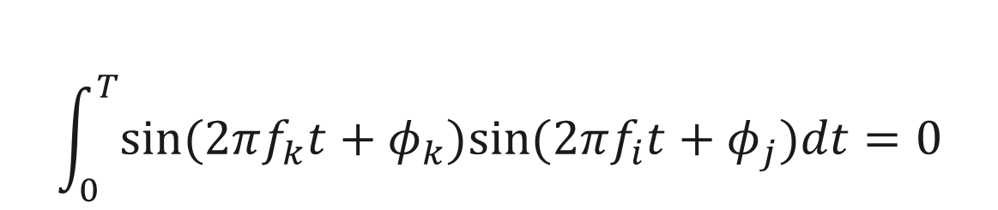
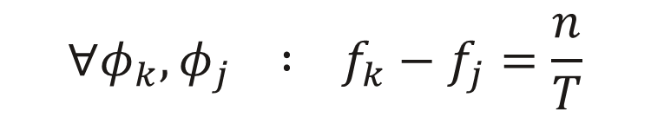
$$x_{k}\left(t\right)=sin(2πf_{k}t) k=0,1,…,K–1$$
$$\int_{0}^{T}{sin⁡(2πf_{k}t+φ_{k})sin⁡(2πf_{i}t+φ_{j})dt}=0$$
$$∀φ_{k}, φ_{j} : f_{k}−f_{j}=\frac{n}{T}$$

Slide 18
OFDM
How to spread information over the subcarriers?
Serial to parallel
Subcarrier 1
Parallel to serial
Subcarrier 2
Bit stream
Subcarrier 3
0 1 0 0 1 1
o o o
Subcarrier n

Slide 19
OFDM
Example with 8 subcarriers
0 1 0 0 1 1 0 1 1 0 0 1 0 1 0 1
Sub 1 | 0 | 1
Sub 2 | 1 | 0
Sub 3 | 0 | 0
Sub 4 | 0 | 1
Sub 5 | 1 | 0
Sub 6 | 1 | 1
Sub 7 | 0 | 0
Sub 8 | 1 | 1
Step 1: Serial to parallel

Slide 20
OFDM
Step 2: Modulate bits on each subcarrier
0
1
BPSK
Sub 1 | 0 | 1
Sub 2 | 1 | 0
Sub 3 | 0 | 0
Sub 4 | 0 | 1
Sub 5 | 1 | 0
Sub 6 | 1 | 1
Sub 7 | 0 | 0
Sub 8 | 1 | 1

Slide 21
OFDM
Step 2: Modulate bits on each subcarrier
0
1
BPSK
Sub 1 | 0 | 1
Sub 2 | 1 | 0
Sub 3 | 0 | 0
Sub 4 | 0 | 1
Sub 5 | 1 | 0
Sub 6 | 1 | 1
Sub 7 | 0 | 0
Sub 8 | 1 | 1
0
0

Slide 22
OFDM
Step 3: Combine subcarriers using IFFT to generate one channel waveform
Sub 1 | 0 | 1
Sub 2 | 1 | 0
Sub 3 | 0 | 0
Sub 4 | 0 | 1
Sub 5 | 1 | 0
Sub 6 | 1 | 1
Sub 7 | 0 | 0
Sub 8 | 1 | 1
o o o
IFFT
Resultant OFDM signal
o o o
o o o

Slide 23
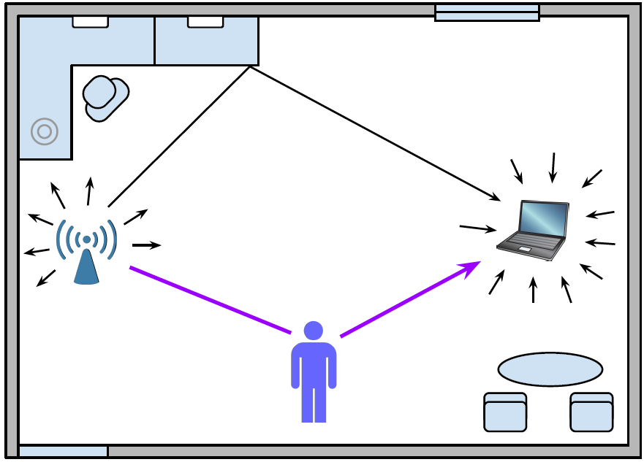
Why OFDM?
Wireless signal propagation is complex
Stationary and moving objects affect the received signal
Signal reaches the receiver over multiple paths
Variations in the environment results in frequency-selective fading

Slide 24
Why OFDM?
Frequency selective fading
Some frequencies within the channel fade severely
These frequencies are uncorrelated
Is it the same as path loss and shadow fading?
Ideal channel
Reality
A
A
f
f
Deep faded frequencies

Slide 25
Why OFDM?
Frequency selective affects only some subcarriers in OFDM
Lower bit error rate
Single carrier
OFDM
A
A
f
f
Deep faded frequencies

Slide 26

OFDM Block Diagram
Transmitter
Error correction coding
Interleaving
(serial to parallel)
Subcarrier modulation
IFFT
Receiver
FFT
Subcarrier demodulation
Parallel to serial
Error correction decoding

Slide 27
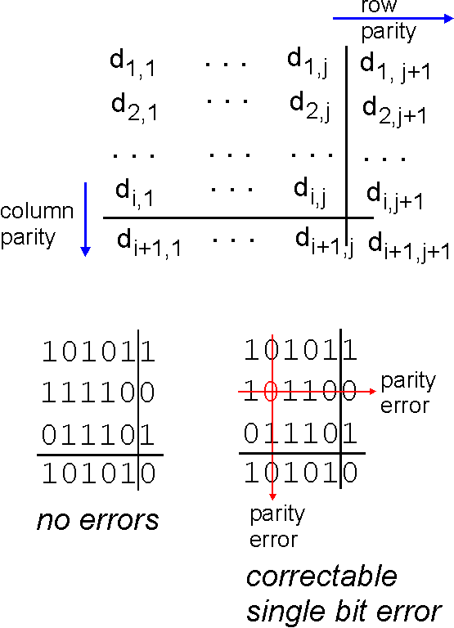
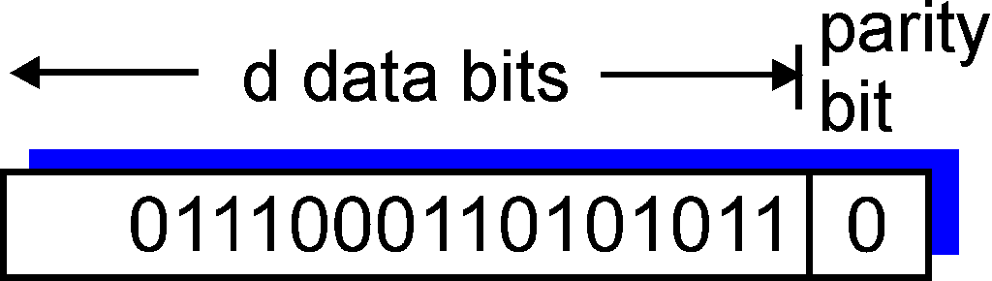

Parity checking
single bit parity:
detect single bit errors
two-dimensional bit parity:
detect and correct single bit errors
Any limitations of this method?
0
0

Slide 28
Forward Error Correction (FEC)
Wireless channel is inherently error prone
Bit errors are common
Can significantly reduce the achievable data rate
FEC
Receiver can detect (to some extent) which bits were corrupted and correct them
Additional parity bits are added to the data bits
Commonly used FEC in 802.11 – Convolution codes
Coding rate
No. of data bits / (no. of data bits + no. of parity bits)
Coding rate of 1/2 means 50% bits are additional parity bits for FEC
Coding rate of 3/4 means 25% bits are additional parity bits for FEC

Slide 29
OFDM in 802.11a PHY
Channel bandwidth – 20 MHz
Total number of OFDM subcarriers – 48
FEC applied first to the incoming data bits
Resultant data+parity bits are input to interleaving

Slide 30
OFDM Block Diagram
Transmitter
Error correction coding
Interleaving
(serial to parallel)
Subcarrier modulation
IFFT
Receiver
FFT
Subcarrier demodulation
Parallel to serial
Error correction decoding

Slide 31
Interleaving
Process of mapping the incoming data bits to subcarriers
In practice, serial to parallel interleaving is not round-robin
General rule
Map the consecutive bits to subcarriers far away from each other
Reduces the probability of consecutive bits being dropped due to fading in nearby subcarriers – improves FEC performance
A
0 1 0 0 1 1 0
f

Slide 32
Modulation
802.11a supports following modulation schemes
Modulation | Bits per symbol
BPSK | 1
QPSK | 2
16-QAM | 4
64-QAM | 6

Slide 33
Block Interleaving
802.11a example
48 subcarriers
Modulation chosen - 64 QAM (6 bits per symbol)
Interleaver buffer size = 48 x 6 = 288 bits
More complex versions of block interleavers used
b₂₄₁ | b₂₄₂
b₁₉₃ | b₁₉₄
b₁₄₅ | b₁₄₆
b₉₇ | b₉₈
b₄₉ | b₅₀
b₁ | b₂
b₂₈₈
b₂₄₀
b₁₉₂
b₁₄₄
b₉₆
b₄₈
0, 1, 0, … , 1
b₁, b₂, b₃, … , b₂₈₈
…
…
…
c₁
c₂
…
c₄₈
Subcarrier no.

Slide 34
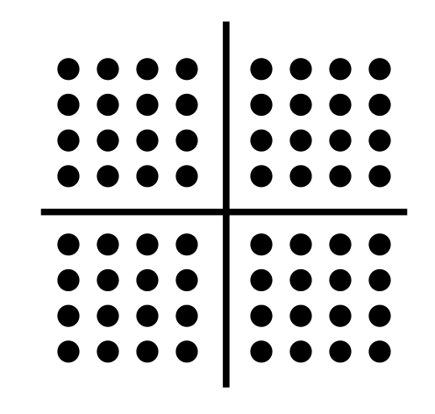
Subcarrier Modulation
Subcarrier symbol
b₂₄₁ | b₂₄₂
b₁₉₃ | b₁₉₄
b₁₄₅ | b₁₄₆
b₉₇ | b₉₈
b₄₉ | b₅₀
b₁ | b₂
b₂₈₈
b₂₄₀
b₁₉₂
b₁₄₄
b₉₆
b₄₈
0, 1, 0, … , 1
b₁, b₂, b₃, … , b₂₈₈
…
…
…
c₁
c₂
…
c₄₈

Slide 35
IFFT
Combine subcarriers
b₂₄₁ | b₂₄₂
b₁₉₃ | b₁₉₄
b₁₄₅ | b₁₄₆
b₉₇ | b₉₈
b₄₉ | b₅₀
b₁ | b₂
b₂₈₈
b₂₄₀
b₁₉₂
b₁₄₄
b₉₆
b₄₈
0, 1, 0, … , 1
b₁, b₂, b₃, … , b₂₈₈
…
…
…
c₁
c₂
…
c₄₈
…
IFFT
Resultant OFDM symbol

Slide 36
802.11a OFDM PHY
Modulation | Coding rate | Coded bits per subcarrier symbol | Coded bits per OFDM symbol | Data bits per OFDM symbol | Data rate (Mbps)
BPSK | 1/2
BPSK | 3/4
QPSK | 1/2
QPSK | 3/4
16-QAM | 1/2
16-QAM | 3/4
64-QAM | 2/3
64-QAM | 3/4

Slide 37
802.11a OFDM PHY
Modulation | Coding rate | Coded bits per subcarrier symbol | Coded bits per OFDM symbol | Data bits per OFDM symbol | Data rate (Mbps)
BPSK | 1/2 | 1
BPSK | 3/4 | 1
QPSK | 1/2 | 2
QPSK | 3/4 | 2
16-QAM | 1/2 | 4
16-QAM | 3/4 | 4
64-QAM | 2/3 | 6
64-QAM | 3/4 | 6

Slide 38
802.11a OFDM PHY
Modulation | Coding rate | Coded bits per subcarrier symbol | Coded bits per OFDM symbol | Data bits per OFDM symbol | Data rate (Mbps)
BPSK | 1/2 | 1 | 48
BPSK | 3/4 | 1 | 48
QPSK | 1/2 | 2 | 96
QPSK | 3/4 | 2 | 96
16-QAM | 1/2 | 4 | 192
16-QAM | 3/4 | 4 | 192
64-QAM | 2/3 | 6 | 288
64-QAM | 3/4 | 6 | 288

Slide 39
802.11a OFDM PHY
Modulation | Coding rate | Coded bits per subcarrier symbol | Coded bits per OFDM symbol | Data bits per OFDM symbol | Data rate (Mbps)
BPSK | 1/2 | 1 | 48 | 24
BPSK | 3/4 | 1 | 48 | 36
QPSK | 1/2 | 2 | 96 | 48
QPSK | 3/4 | 2 | 96 | 72
16-QAM | 1/2 | 4 | 192 | 96
16-QAM | 3/4 | 4 | 192 | 144
64-QAM | 2/3 | 6 | 288 | 192
64-QAM | 3/4 | 6 | 288 | 216

Slide 40
802.11a OFDM PHY
Modulation | Coding rate | Coded bits per subcarrier symbol | Coded bits per OFDM symbol | Data bits per OFDM symbol | Data rate (Mbps)
BPSK | 1/2 | 1 | 48 | 24 | 6
BPSK | 3/4 | 1 | 48 | 36 | 9
QPSK | 1/2 | 2 | 96 | 48 | 12
QPSK | 3/4 | 2 | 96 | 72 | 18
16-QAM | 1/2 | 4 | 192 | 96 | 24
16-QAM | 3/4 | 4 | 192 | 144 | 36
64-QAM | 2/3 | 6 | 288 | 192 | 48
64-QAM | 3/4 | 6 | 288 | 216 | 54

Slide 41
OFDM Block Diagram
Transmitter
Error correction coding
Interleaving
(serial to parallel)
Subcarrier modulation
IFFT
Receiver
FFT
Subcarrier demodulation
Parallel to serial
Error correction decoding

Slide 42
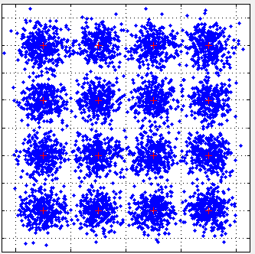
Demodulation
Received symbols depend on channel variations
Multi-path – common reason behind amplitude and phase changes
Inter-symbol interference
Transmitter
Receiver
Mathworks - digital modulation with Matlab http://www.mathworks.com/help/comm/ug/digital-modulation_ja_JP.html

Slide 43
Demodulation
Hard decision
Calculate the distance to the constellation points, pick the one with the lowest distance
Can be overly conservative
Receiver

Slide 44
Demodulation
Soft decision
For the received symbol, calculate its distance to the nearby constellation points
Use the distance to associate a probability to the constellation point
Combine the probabilities with FEC decoding to minimize errors
Receiver

Slide 45
Bit to symbol mapping
Natural vs. gray mapping in 16 QAM
Gray mapping: adjacent constellation points only differ in 1 bit
Reduces bit error compared to natural mapping where adjacent points can have multiple bits different from each
3 (0011)
2 (0010)
1 (0001)
0 (0000)
2 (0010)
6 (0110)
14(1110)
10(1010)
7 (0111)
6 (0110)
5 (0101)
4 (0100)
3(0011)
7(0111)
15(1111)
11(1011)
11(1011)
10(1010)
9 (1001)
8 (1000)
1(0001)
5(0101)
13(1101)
9(1001)
15(1111)
14(1110)
13(1101)
12(1100)
0(0000)
4(0100)
12(1100)
8 (1000)
Natural mapping
Gray mapping

Slide 46
OFDM in 802.11n
802.11n uses 20 and 40 MHz channel widths
Following data rates refer to 20 MHz channels
Modulation | Coding rate | Data rate (Mbps)
BPSK | 1/2 | 6.5
QPSK | 1/2 | 13
QPSK | 3/4 | 19.5
16-QAM | 1/2 | 26
16-QAM | 3/4 | 39
64-QAM | 2/3 | 52
64-QAM | 3/4 | 58.5
64-QAM | 5/6 | 65

Slide 47
OFDM in 802.11ac
802.11ac uses wider channel widths
20, 40, 80 and 160 MHz
More subcarriers for OFDM
For higher data rates, 160 MHz channel width and 256 QAM modulation can be used
Channel width (MHz) | OFDM subcarriers
20 | 52
40 | 108
80 | 234
160 | 468

