Slide 1


مدارهای منطقی
فصل دوم-جبر بول
Boolean Algebra and Logic Gates
وحید حقیقت دوست
haghighatdoost@shahed.ac.ir
http://ref.shahed.ac.ir/haghighatdoost
دانشکده فنی و مهندسی

Slide 2
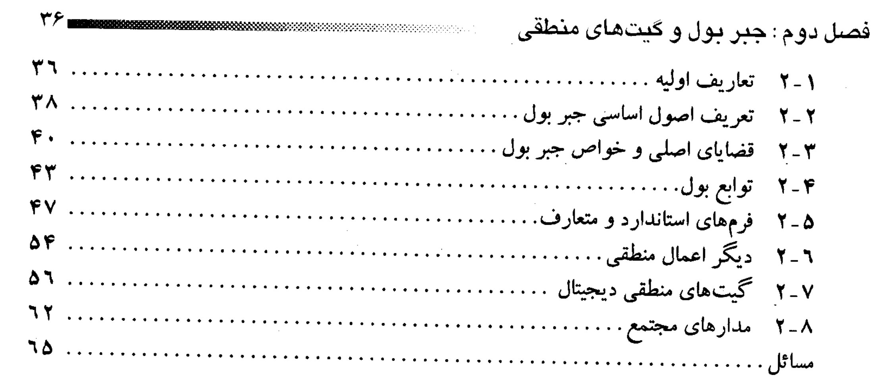

Slide 3
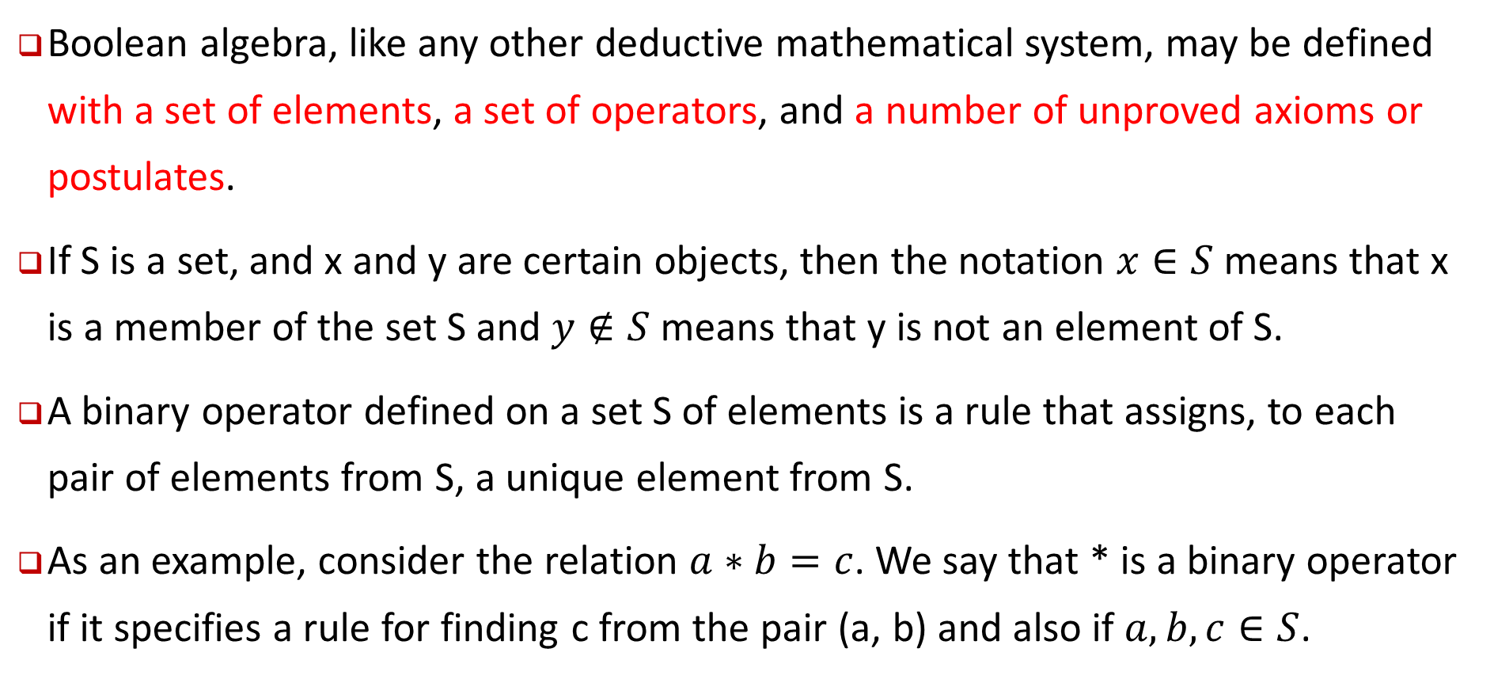
Basic Definitions
Boolean algebra, like any other deductive mathematical system, may be defined with a set of elements, a set of operators, and a number of unproved axioms or postulates.
If S is a set, and x and y are certain objects, then the notation $x∈S$means that x is a member of the set S and $y∉S$ means that y is not an element of S.
A binary operator defined on a set S of elements is a rule that assigns, to each pair of elements from S, a unique element from S.
As an example, consider the relation $a∗b=c$. We say that * is a binary operator if it specifies a rule for finding c from the pair (a, b) and also if $a, b, c∈S$.

Slide 4
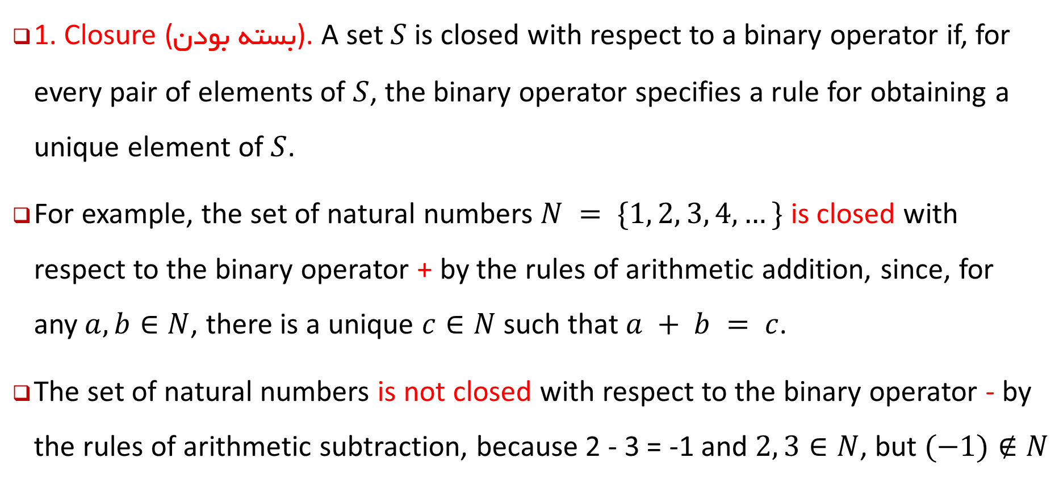
The most common postulates used to formulate various algebraic structures:
1. Closure (بسته بودن). A set $S$ is closed with respect to a binary operator if, for every pair of elements of $S$, the binary operator specifies a rule for obtaining a unique element of $S$.
For example, the set of natural numbers $N = \{1, 2, 3, 4, …\}$ is closed with respect to the binary operator + by the rules of arithmetic addition, since, for any$a, b∈N$, there is a unique $c∈N$such that $a + b = c$.
The set of natural numbers is not closed with respect to the binary operator - by the rules of arithmetic subtraction, because 2 - 3 = -1 and $2, 3∈N$, but $(−1)∉N$

Slide 5
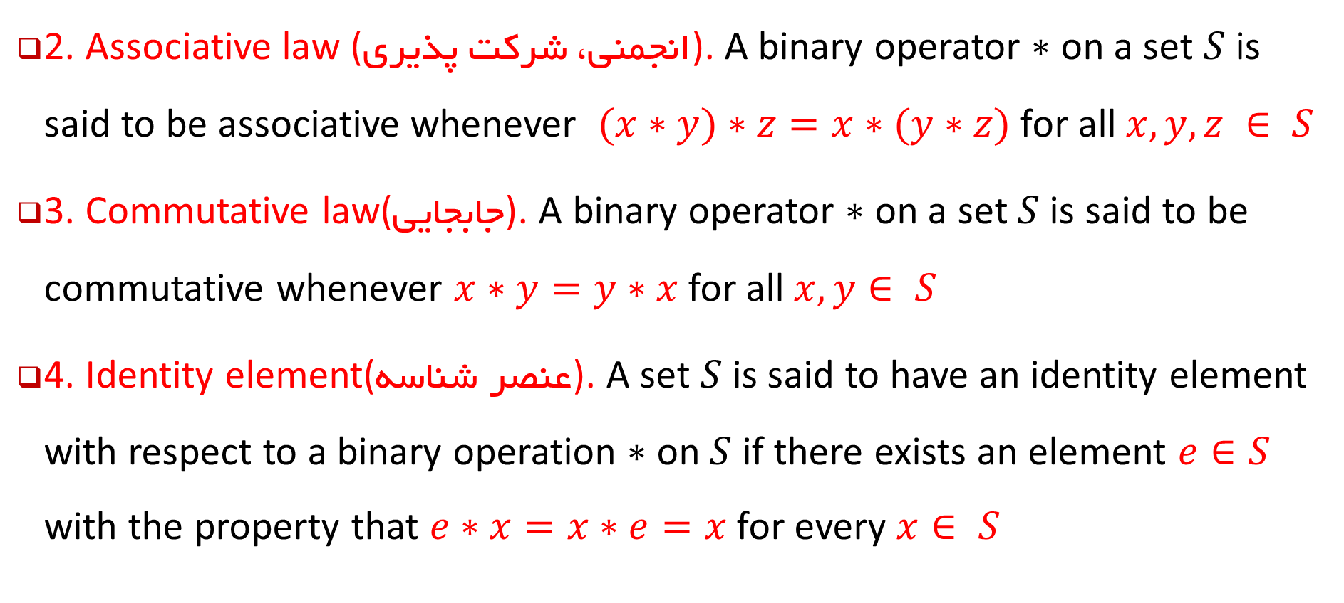
The most common postulates used to formulate various algebraic structures:
2. Associative law (انجمنی، شرکت پذیری). A binary operator $∗$ on a set $S$ is said to be associative whenever $(x∗y)∗z=x∗(y∗z)$ for all $x, y, z ∈ S$
3. Commutative law(جابجایی). A binary operator $∗$ on a set $S$ is said to be commutative whenever $x∗y=y∗x$for all $x, y∈ S$
4. Identity element(عنصر شناسه). A set $S$ is said to have an identity element with respect to a binary operation $∗$ on $S$ if there exists an element $e∈S$ with the property that $e∗x=x∗e=x$for every $x∈ S$

Slide 6
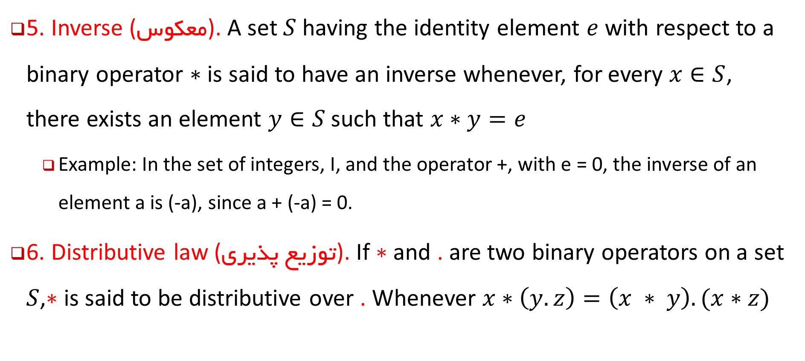
The most common postulates used to formulate various algebraic structures:
5. Inverse (معکوس). A set $S$having the identity element $e$ with respect to a binary operator $∗$ is said to have an inverse whenever, for every $x∈S$, there exists an element $y∈S$such that $x∗y=e$
Example: In the set of integers, I, and the operator +, with e = 0, the inverse of an element a is (-a), since a + (-a) = 0.
6. Distributive law (توزیع پذیری). If $∗$ and . are two binary operators on a set $S$,$∗$ is said to be distributive over . Whenever $x∗\left(y. z\right)=\left(x ∗ y\right). (x∗z)$

Slide 7
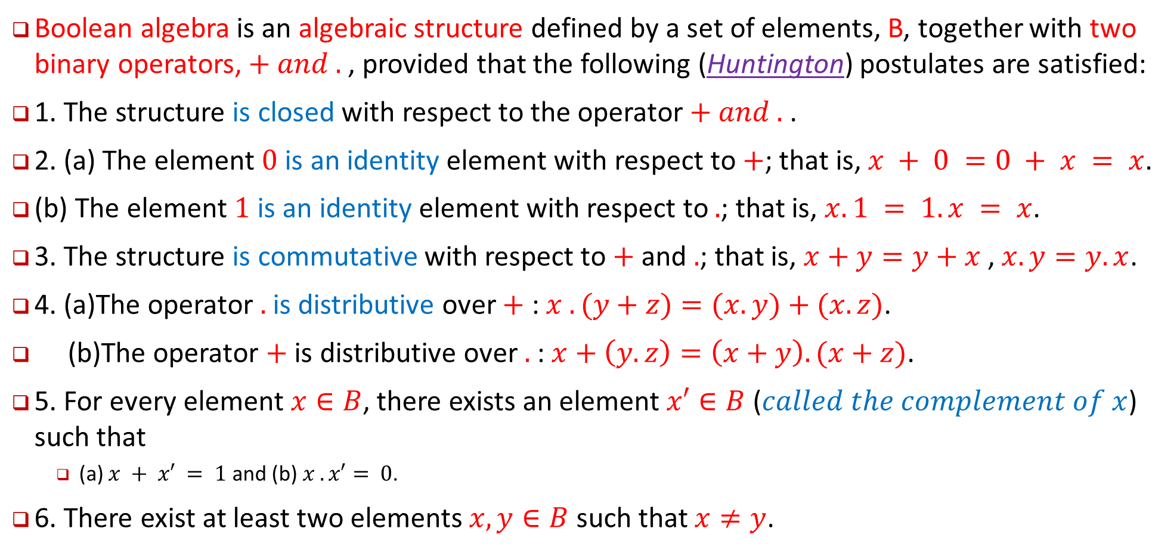
Axiomatic Definition Of Boolean Algebra تعریف اصول جبر بول-اصول هانینگتون
Boolean algebra is an algebraic structure defined by a set of elements, B, together with two binary operators, $+ and .$, provided that the following (Huntington) postulates are satisfied:
1. The structure is closed with respect to the operator$+ and .$ .
2. (a) The element $0$ is an identity element with respect to $+$; that is, $x + 0 =0 + x = x$.
(b) The element $1$ is an identity element with respect to $.$; that is, $x.1 = 1.x = x$.
3. The structure is commutative with respect to $+$ and $.$; that is, $x+y=y+x$ , $x.y=y.x$.
4. (a)The operator $.$ is distributive over $+$ : $x . (y+z)=(x.y)+(x.z)$.
(b)The operator $+$ is distributive over $.$ : $x+\left(y.z\right)=\left(x+y\right).(x+z)$.
5. For every element $x∈B$, there exists an element $x′∈B$ ($called the complement of x$) such that
(a) $x + x′ = 1$ and (b) $x . x′= 0$.
6. There exist at least two elements $x, y∈B$ such that $x≠y$.

Slide 8
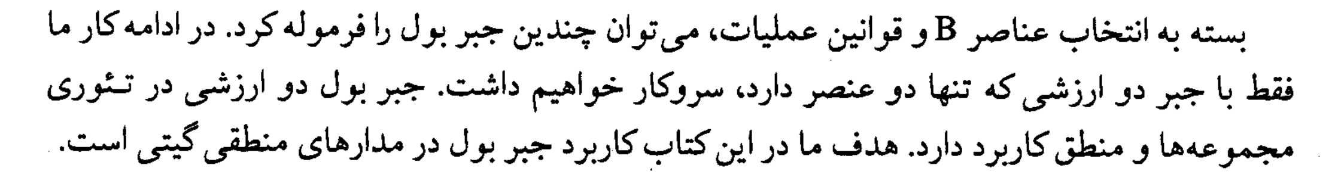
One can formulate many Boolean algebras, depending on the choice of elements of B and the rules of operation. In our subsequent work, we deal only with a two‐valued Boolean algebra (i.e., a Boolean algebra with only two elements).
Our interest here is in the application of Boolean algebra to gate‐type circuits commonly used in digital devices and computers.

Slide 9
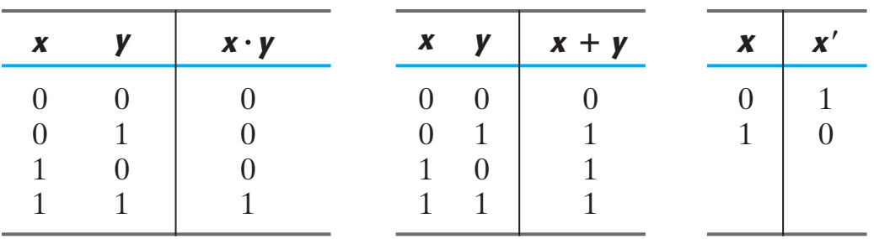
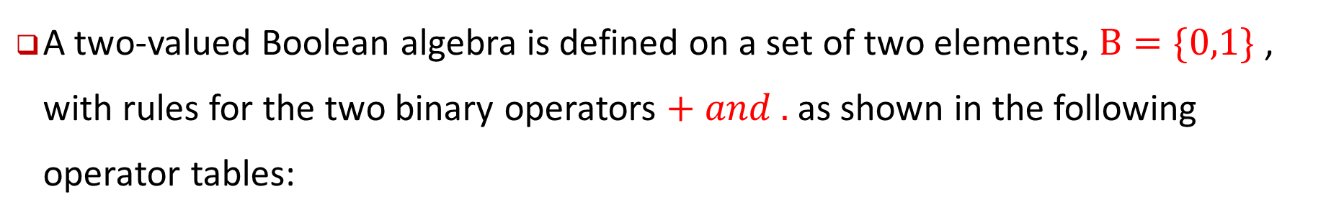
Two‐Valued Boolean Algebra (جبر بول دو ارزشی)
A two‐valued Boolean algebra is defined on a set of two elements, $B=\{0,1\}$ , with rules for the two binary operators $+ and .$as shown in the following operator tables:
These rules are exactly the same as the AND, OR, and NOT operations

Slide 10
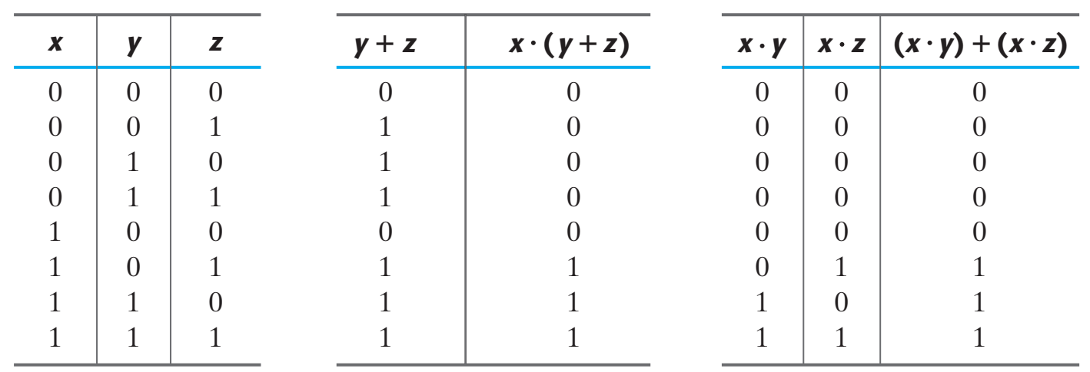
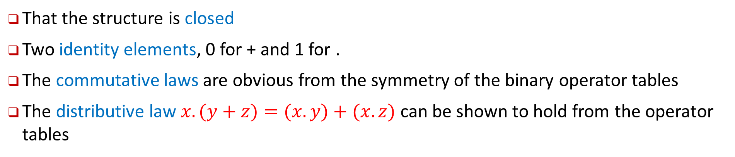
Checking Huntington postulates
That the structure is closed
Two identity elements, 0 for + and 1 for .
The commutative laws are obvious from the symmetry of the binary operator tables
The distributive law $x.(y+z)=(x.y)+(x. z)$ can be shown to hold from the operator tables

Slide 11
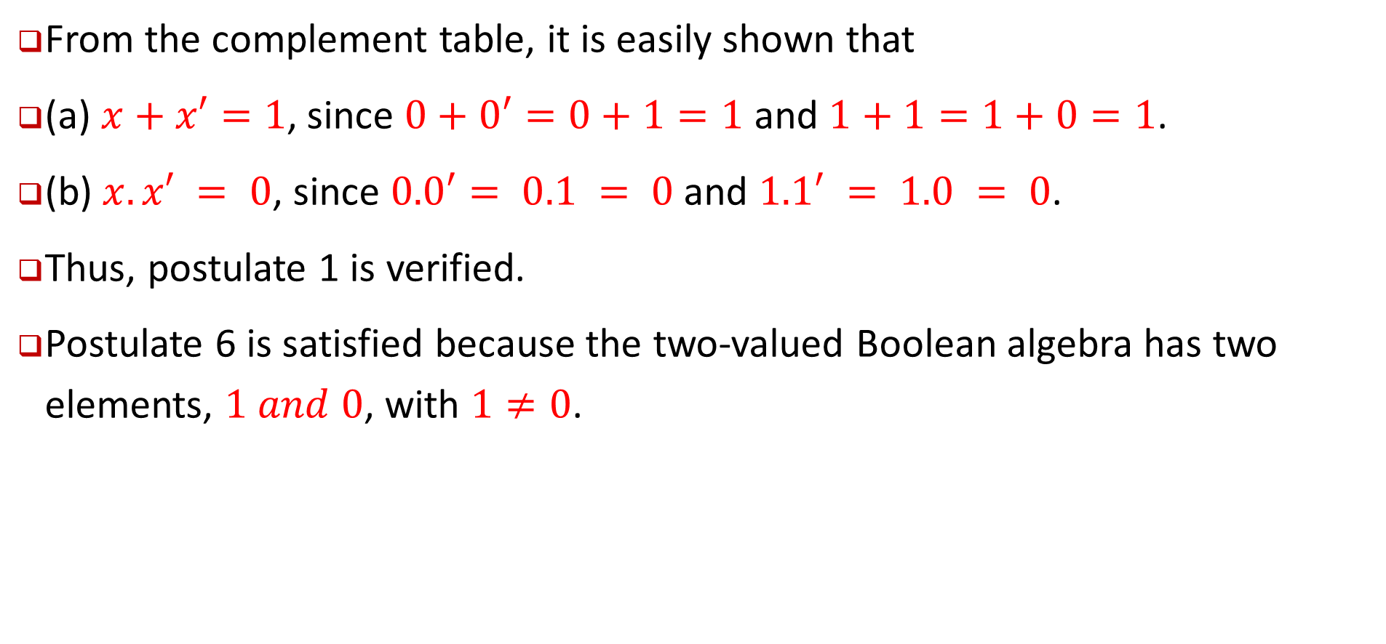
Checking Huntington postulates
From the complement table, it is easily shown that
(a) $x+x′=1$, since $0+0′=0+1=1$ and $1+1=1+0=1$.
(b) $x. x′ = 0$, since $0.0′= 0.1 = 0$and $1.1′ = 1.0 = 0$.
Thus, postulate 1 is verified.
Postulate 6 is satisfied because the two‐valued Boolean algebra has two elements, $1 and 0$, with $1≠0$.

Slide 12
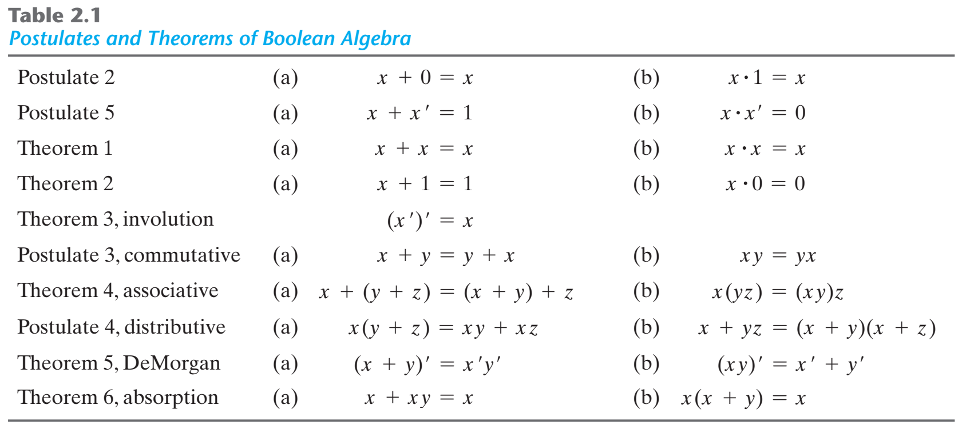
Postulates and Theorems of Boolean Algebra اصول و قضایای جبر بول

Slide 13
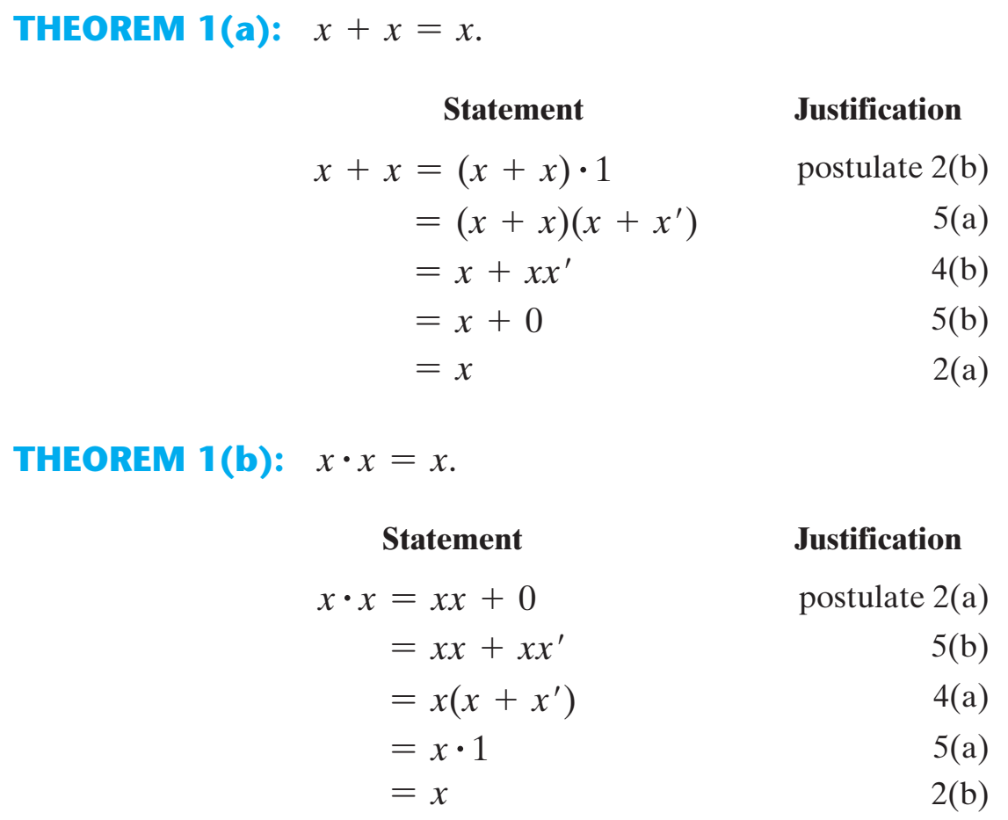

Slide 14
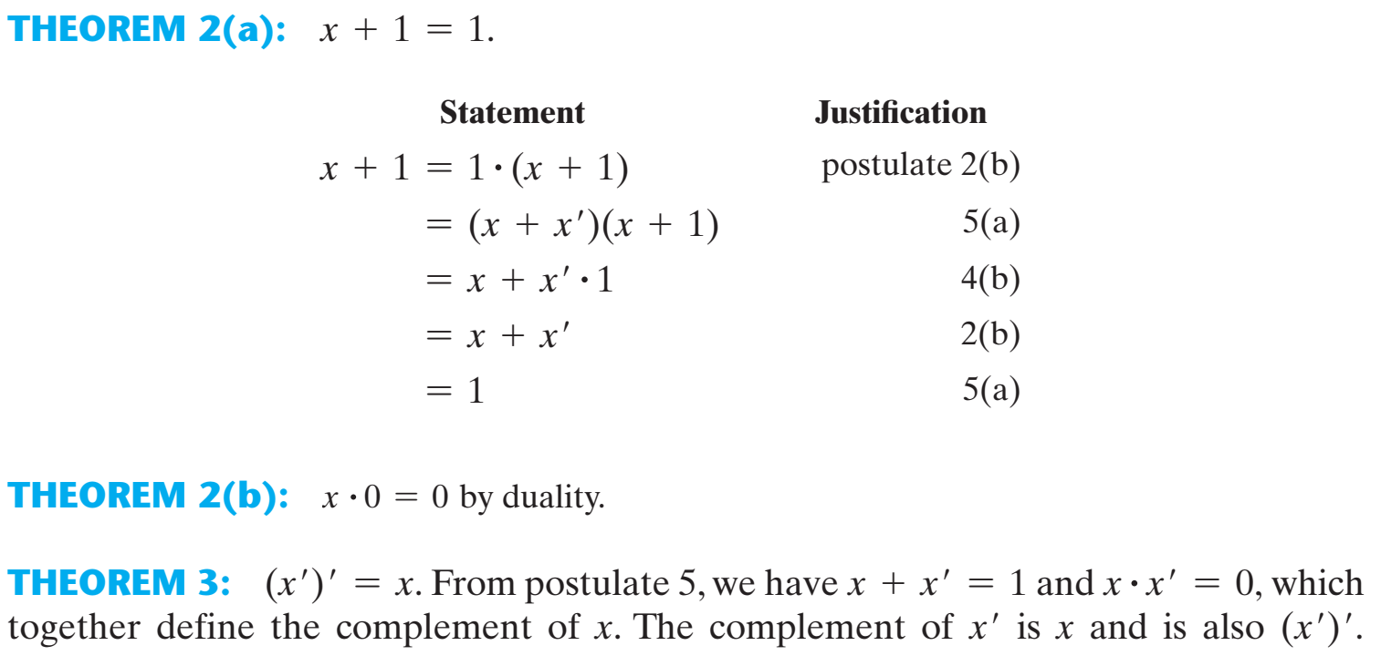

Slide 15
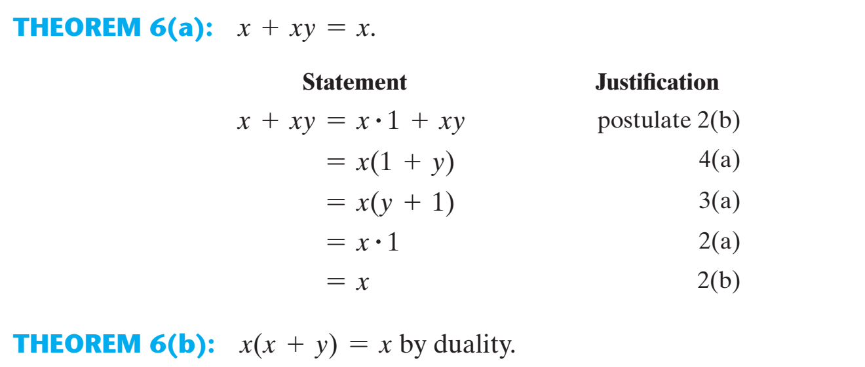

Slide 16
Operator Precedence تقدم عملگرها
The operator precedence for evaluating Boolean expressions is
(1) parentheses, (2) NOT, (3) AND, and (4) OR.

Slide 17
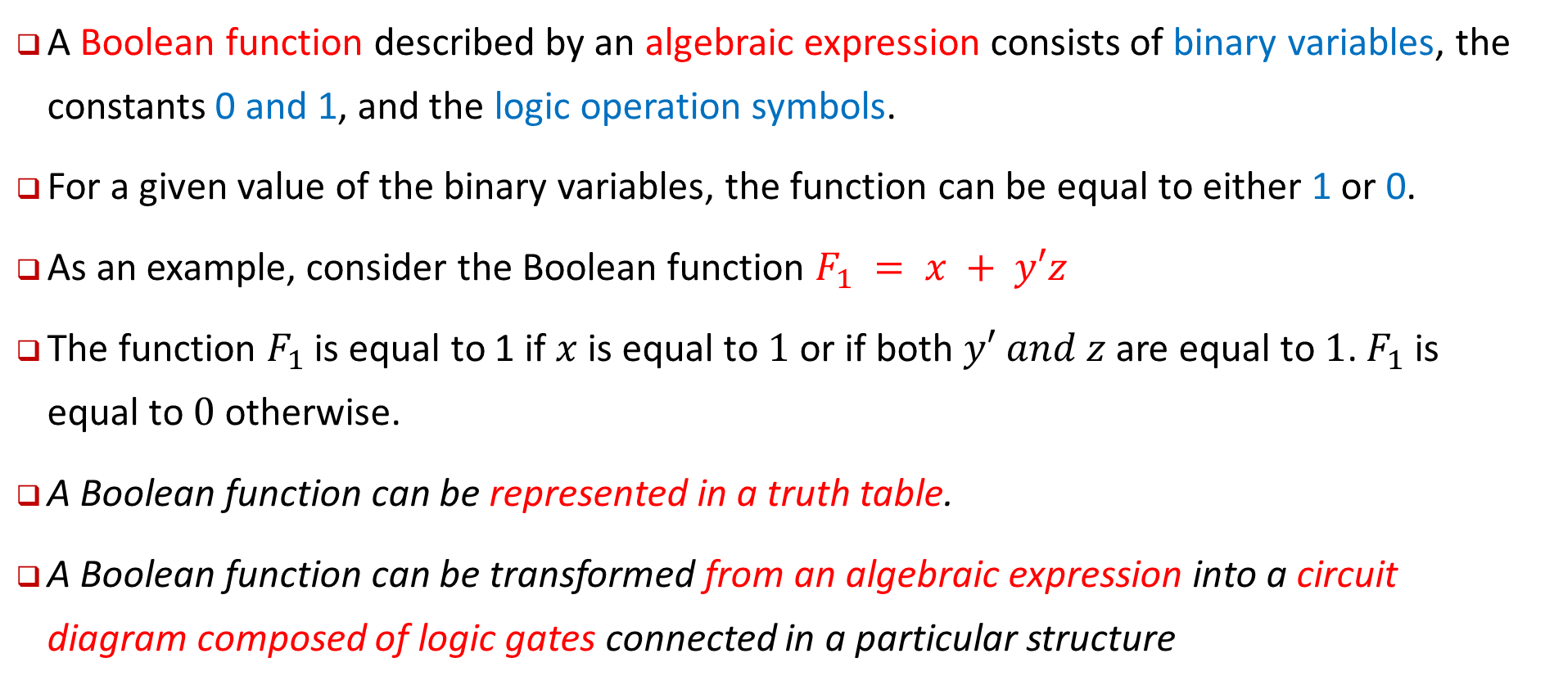
Boolean Functions
A Boolean function described by an algebraic expression consists of binary variables, the constants 0 and 1, and the logic operation symbols.
For a given value of the binary variables, the function can be equal to either 1 or 0.
As an example, consider the Boolean function $F_{1} = x + y′z$
The function $F_{1}$ is equal to 1 if $x$ is equal to $1$ or if both $y′ and z$are equal to $1$. $F_{1}$ is equal to $0$ otherwise.
A Boolean function can be represented in a truth table.
A Boolean function can be transformed from an algebraic expression into a circuit diagram composed of logic gates connected in a particular structure

Slide 18
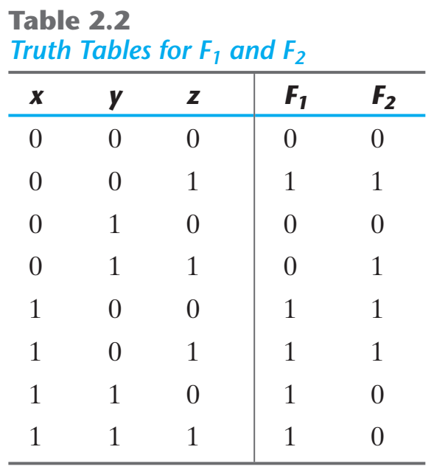
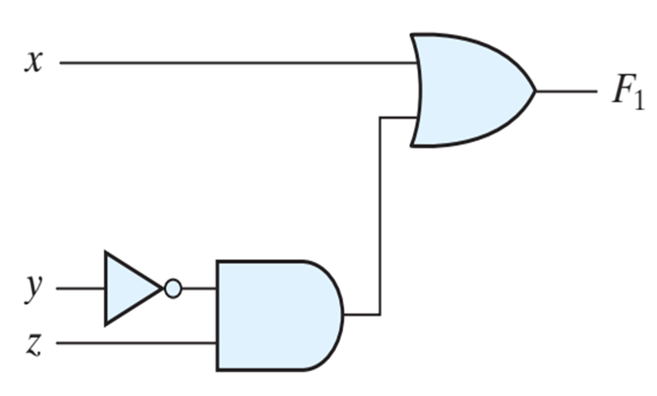
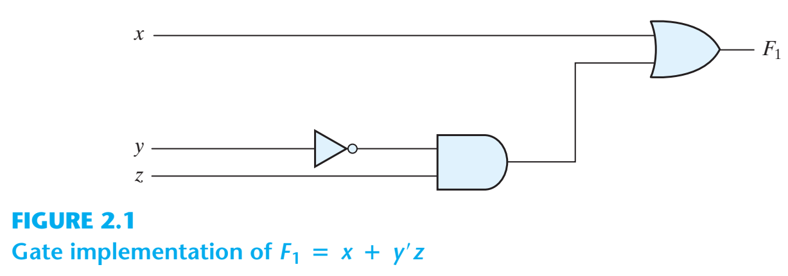


$$F_{1} = x + y′z$$
A Boolean function can be transformed from an algebraic expression into a circuit diagram composed of logic gates connected in a particular structure.
$$F_{2}= x′y′z + x′yz + xy′$$

Slide 19
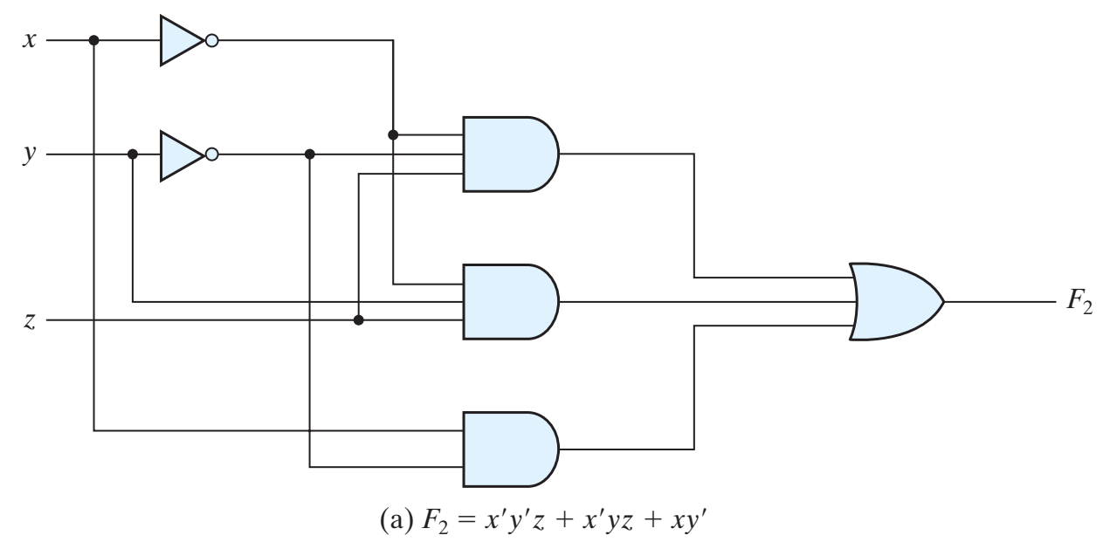
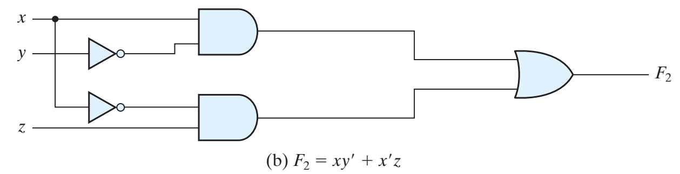

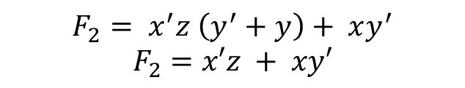
EXAMPLE
$$F_{2}= x′y′z + x′yz + xy′$$
$$F_{2}= x^{′}z \left(y^{′}+y\right)+ xy^{′}$$
$$F_{2}=x′z + xy′$$

Slide 20
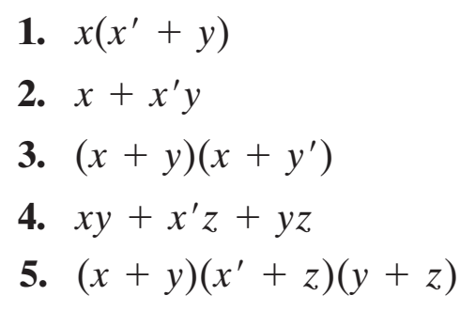
EXAMPLE 2.1
Draw the circuit related to bellow Boolean functions

Slide 21
EXAMPLE 2.1
Simplify the following Boolean functions to a minimum number of literals

Slide 22
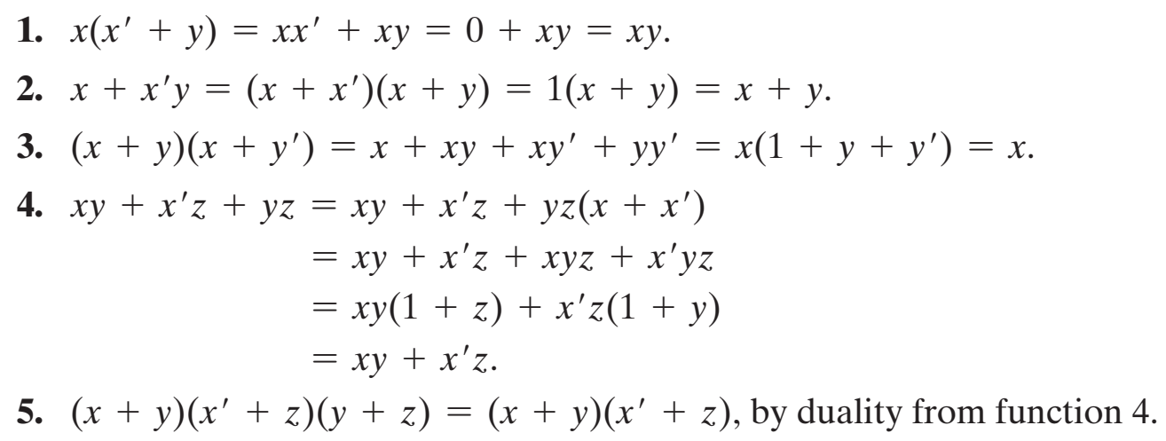
EXAMPLE 2.1 (solve)
Simplify the following Boolean functions to a minimum number of literals

Slide 23
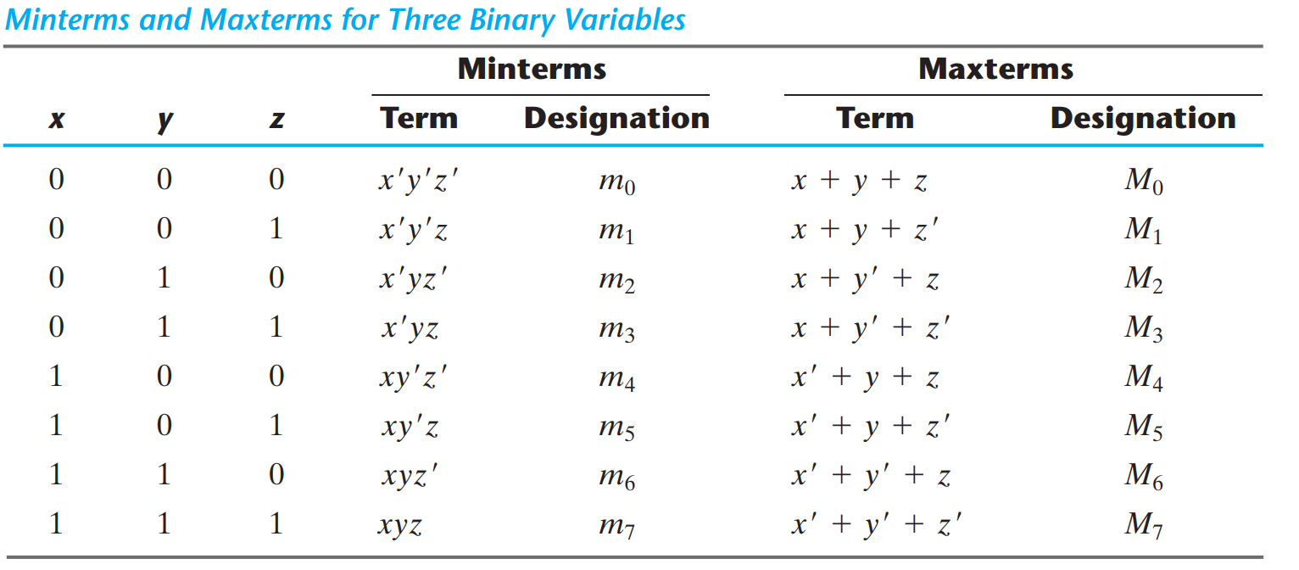
Canonical And Standard Forms
Minterms and Maxterms
هر ترکیب ایجاد شده از ضرب متغیرها و یا متمم متغیرها را یک Minterm میگوییم
هر ترکیب ایجاد شده از جمع متغیرها و یا متمم متغیرها را یک Maxterm میگوییم

Slide 24
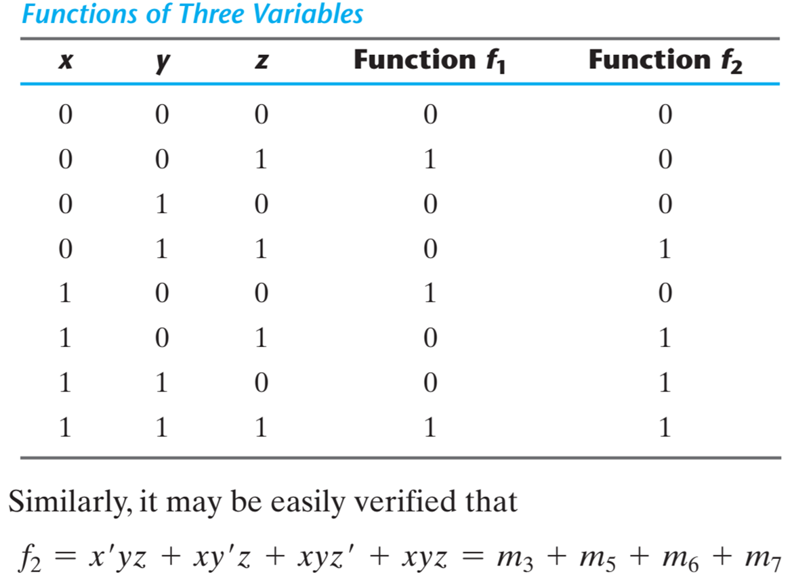
Functions and Minterms
Any Boolean function can be expressed as a sum of minterms (with “sum” meaning the ORing of terms)
هر تابع بول را میتوان بصورت حاصل جمع مینترمها نوشت
Boolean functions expressed as a sum of minterms or product of maxterms are said to be in canonical form
هر تابع بول که بصورت حاصل جمع مینترمها و یا حاصل ضرب ماکسترمها نوشته شده باشد را فرم متعارف میگویند.

Slide 25
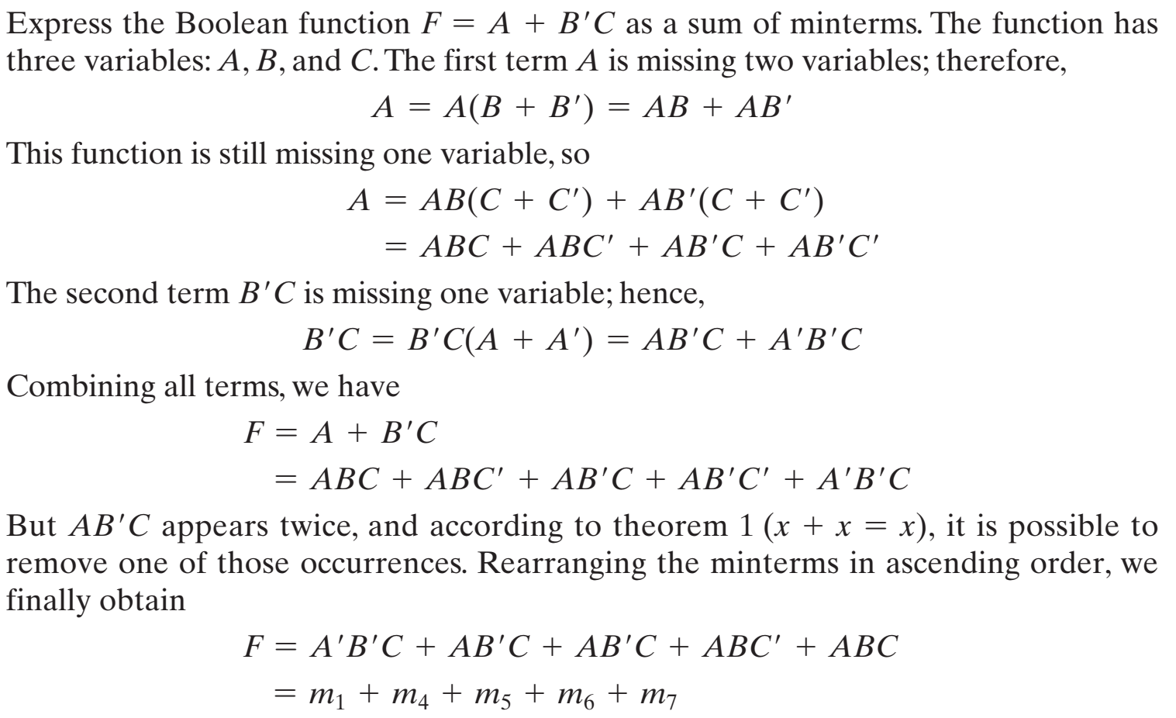
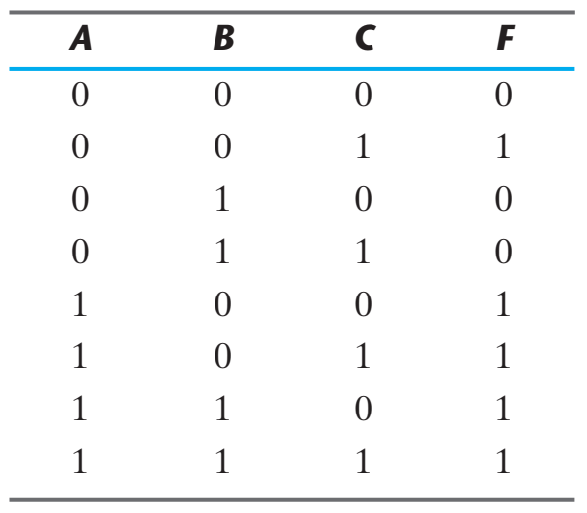

Example 2.4

Slide 26



Conversion between Canonical Forms
معکوس مینترم $j$ برابر است با ماکسترم $j$

Slide 27
باتوجه به مقدمات بیان شده، هر تابع بولی را میتوان با استفاده از گیتهای منطقی در دو سطح پیاده سازی کرد:
قدم اول) تبدیل تابع به فرم نرمال متعارف (معمولاً حاصل جمع مینترمها)
قدم دوم) ارائه ورودی ها و ایجاد تمامی مینترمها (گیتهای AND در لایه اول(
قدم سوم) اتصال مینترمهای انتخاب شده به ورودی گیت OR خروجی

Slide 28
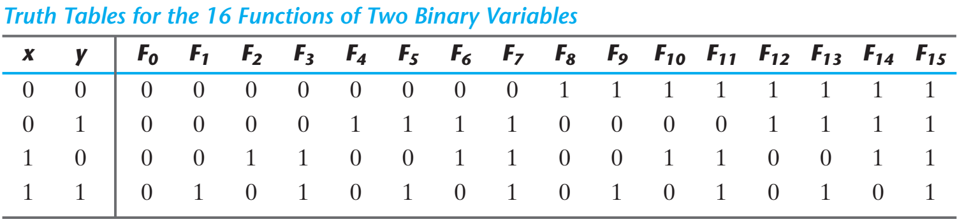
Other Logic Operators (سایر عملگرهای منطقی)
اگر ما دو ورودی x و y را برای تابع متصور شویم، در اینصورت 16 تابع مختلف ممکن است روی این دو ورودی تعریف شوند.

Slide 29
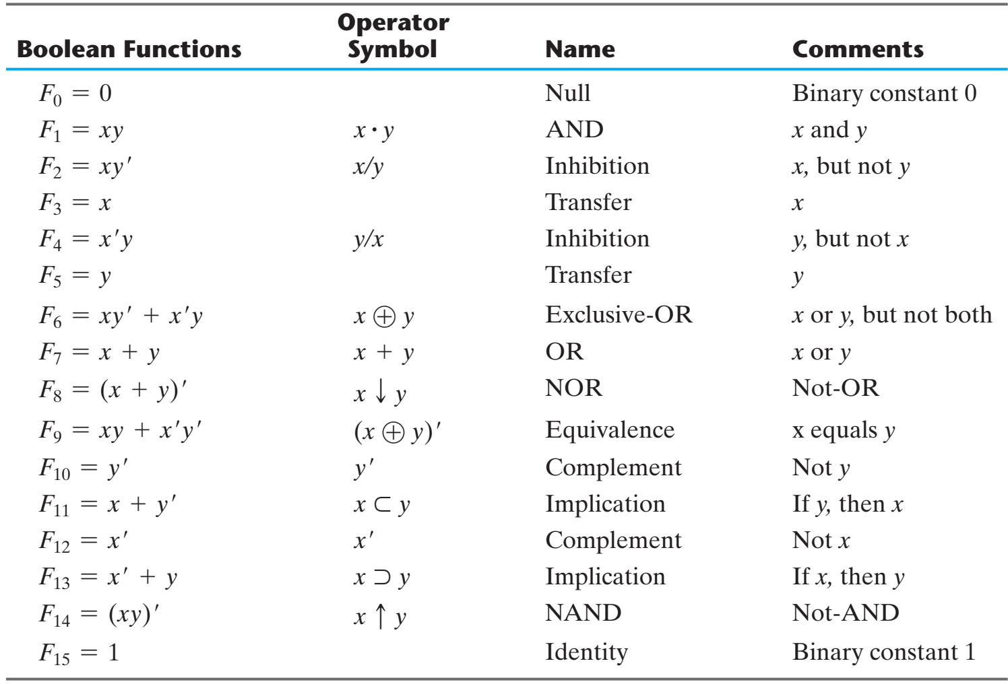

Slide 30
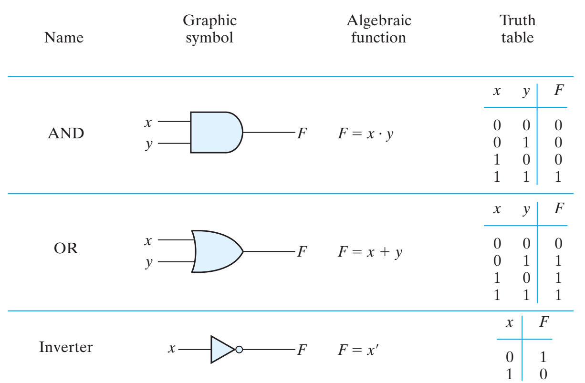
Graphic Symbols and Digital logic gates

Slide 31
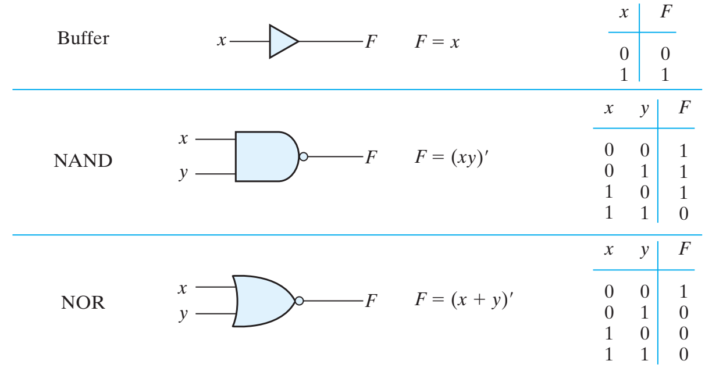
Graphic Symbols and Digital logic gates

Slide 32
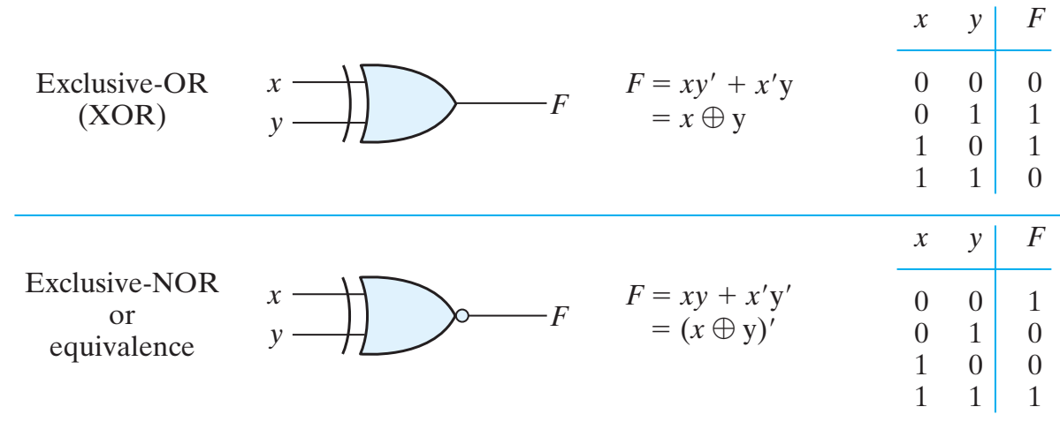
Graphic Symbols and Digital logic gates

Slide 33
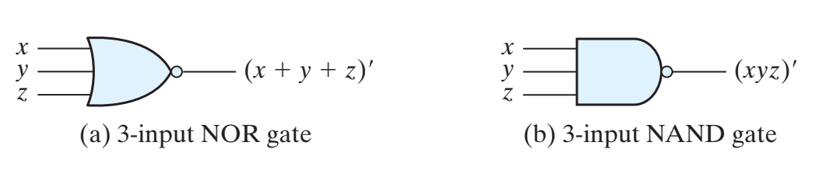
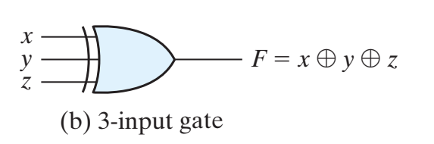
Extension to Multiple Inputs(گیت های با ورودی های بیشتر)

Slide 34
Levels of Integration(مدارهای مجتمع)
Small‐scale integration (SSI) devices contain several independent gates in a single package.
The inputs and outputs of the gates are connected directly to the pins in the package.
The number of gates is usually fewer than 10 and is limited by the number of pins available in the IC.
Medium‐scale integration (MSI) devices have a complexity of approximately 10 to 1,000 gates in a single package.
They usually perform specific elementary digital operations. MSI digital functions such as decoders, adders, multiplexers, registers and counters.
Large‐scale integration (LSI) devices contain thousands of gates in a single package.
They include digital systems such as processors, memory chips, and programmable logic devices.
Very large‐scale integration (VLSI) devices now contain millions of gates within a single package.
Examples are large memory arrays and complex microcomputer chips.

Slide 35







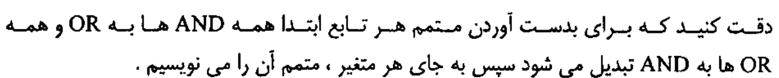
تمرین کلاسی:

Slide 36
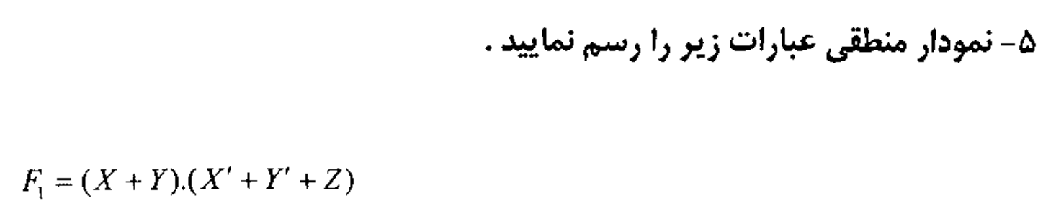
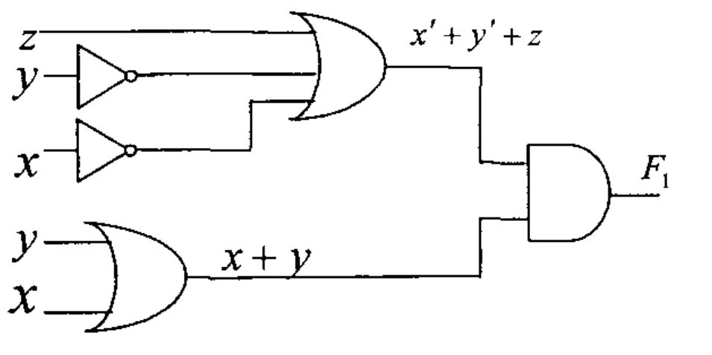

Slide 37
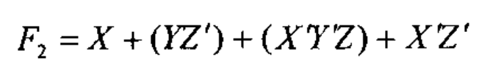
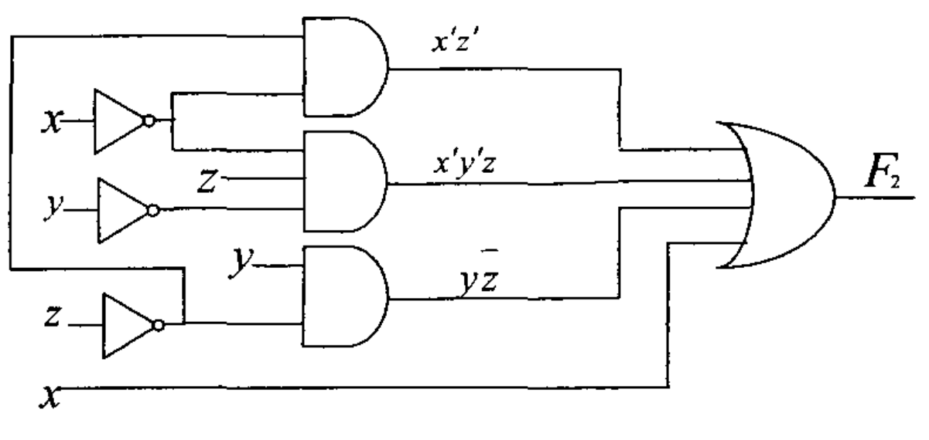

Slide 38
End of Chapter 2

