Slide 1


معماری کامپیوتر پیشرفته
فصل دوم
Memory Hierarchy Design
وحید حقیقت دوست
haghighatdoost@shahed.ac.ir
http://ref.shahed.ac.ir/haghighatdoost
دانشکده فنی و مهندسی

Slide 2
Computer Architecture
A Quantitative Approach, Sixth Edition
Chapter 2
Memory Hierarchy Design
Hohn L. Hennessy
David A. Patterson

Slide 3
Writes Vs. Reads
Reads are more common.
data access:
10% stores and 37% loads for MIPS programs,
making writes 10%/(100% + 37% + 10%) or about 7% of the overall memory traffic.
Or 10%/(37%+10%) or 21% of data cache traffic.
Make the common case fast: Read.
The block can be read the same time the tag is read and compared. (for DM)
Embedded processors might not like this.
This optimization is not valid for write.
Where to write the data if the block is/not found in cache?
Notes:
Embedded’s emphasis on power generally means avoiding
unnecessary work, which might lead the designer to separate data read from ad-dress
check so that data is not read on a miss.

Slide 4
What Happens on Writes
Write through: new data is written to both the cache block and the lower-level memory.
Help to maintain cache consistency.
Write back: new data is written only to the cache block.
Lower-level memory is updated when the block is replaced.
A dirty bit is used to indicate the necessity.
Help to reduce memory traffic.
What happens if the block is not found in cache?

Slide 5
Write Allocation
Write allocate: Fetch the block into cache, then write the data (usually combined with write back).
No-write allocate: Do not fetch the block into cache (usually combined with write through).
معمولاً Write Allocate با Write back استفاده میشود و No-write allocate با Write through استفاده میشود
Pros and Cons of each when the block is not found in cache?
WT: read misses cannot result in writes.
WB: no repeated writes to same location.
WT always combined with write buffers so that don’t wait for lower level memory.

Slide 6
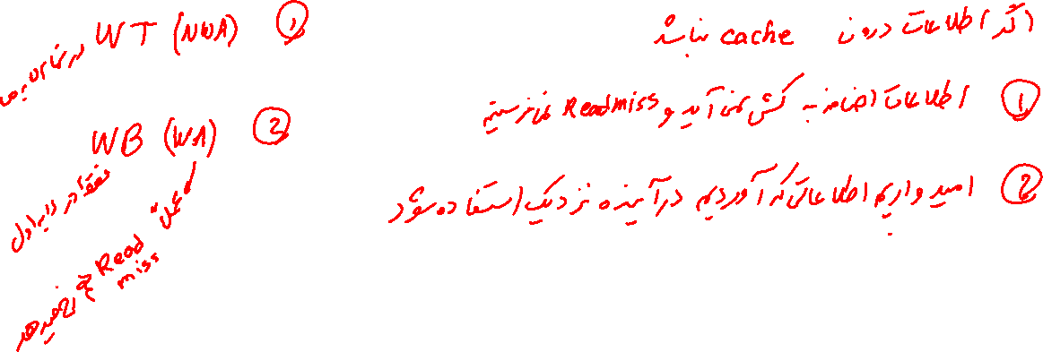

Slide 7
Write Buffer for Write Through
Cache
Processor
DRAM
Write Buffer
A Write Buffer is needed between the Cache and Memory
Processor: writes data into the cache and the write buffer
Memory controller: write contents of the buffer to memory
Write buffer is just a FIFO:
Typical number of entries: 4
Works fine if: Store frequency << 1 / DRAM write cycle
Memory system designer’s nightmare:
Store frequency ≥ 1 / DRAM write cycle
Write buffer saturation
Notes:
frequency with respect to time, not with respect to number of instructions
Store frequency (w.r.t. time)
You are right, memory is too slow. We really didn't writ e to the memory directly. We are writing to a write buffer.
Once the data is written into the write buffer and assuming a cache hit, the CPU is done with the write. The memory controller will then move the write buffer’s contents to the real memory behind the scene.
The write buffer works as long as the frequency of store is not too high. Notice here, I am referring to the frequency with respect to time, not with respect to number of instructions.
Remember the DRAM cycle time we talked about last time. It sets the upper limit on how frequent you can write to the main memory.
If the store are too close together or the CPU time is so much faster than the DRAM cycle time, you can end up overflowing the write buffer and the CPU must stop and wait.
+2 = 60 min. (Y:40)

Slide 8
Basics of Cache Operation
Write through
Write back

Slide 9
Memory Hierarchy Basics
Miss rate
Fraction of cache access that result in a miss
Causes of misses
Compulsory
First reference to a block
Capacity
Blocks discarded and later retrieved
Conflict
Program makes repeated references to multiple addresses from different blocks that map to the same location in the cache

Slide 10
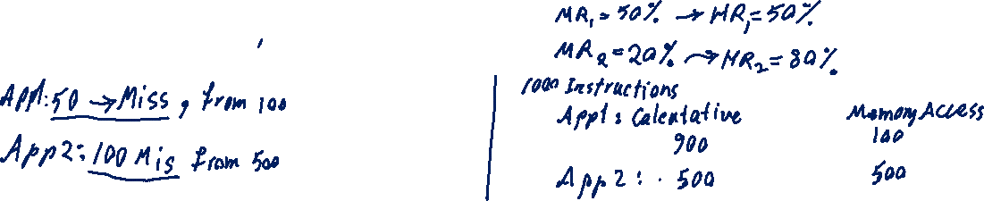
Memory Hierarchy Basics
دو برنامه با 1000 دستور العمل را در نظر بگیرید. برنامه اول 100 دستور دسترسی به حافظه دارد و برنامه دوم 500 دستور دسترسی به حافظه. برنامه اول را روی ماشینی با MR=50% و برنامه دوم را روی ماشینی با MR=20% اجرا میکنیم.

Slide 11
Memory Hierarchy Basics
Speculative and multithreaded processors may execute other instructions during a miss
Reduces performance impact of misses

Slide 12
Replacement Policy
Cache has finite size
What do we do when it is full?
Analogy: desktop full?
Move books to bookshelf to make room
Same idea:
Move blocks to next level of cache

