Slide 1


معماری کامپیوتر پیشرفته
فصل دوم
Memory Hierarchy Design
Replacement Policy
وحید حقیقت دوست
haghighatdoost@shahed.ac.ir
http://ref.shahed.ac.ir/haghighatdoost
دانشکده فنی و مهندسی

Slide 2
Copyright Notice
Lectures adopted from
Computer Architecture: A Quantitative Approach, 5th edition, John L. Hennessy,‎ David A. Patterson, MK pub., 2019

Slide 3
Computer Architecture
A Quantitative Approach, Sixth Edition
Chapter 2
Memory Hierarchy Design
Hohn L. Hennessy
David A. Patterson

Slide 4
Replacement Policy
Cache has finite size
What do we do when it is full?
Analogy: desktop full?
Move books to bookshelf to make room
Same idea:
Move blocks to next level of cache

Slide 5
Replacement Policy
How do we choose victim?
Verbs: Victimize, evict, replace, cast out
Many policies are possible
FIFO (first-in-first-out), shows anomaly
Check line reference list 4 3 2 1 4 3 5 4 3 2 1 5 for 3-way and 4-way set
LRU (least recently used), pseudo-LRU
LFU (least frequently used)
NRU (not recently used)
Random → Pseudo-random
Optimal
بهترین گزینه برای اخراج گزینه ای است که دیرتر از سایر بلاکهای موجود، به آن دسترسی خواهیم داشت.
Notes:
سیاست اپتیمال وجود ندارد
بهترین گزینه برای اخراج گزینه ای است که دیرتر از سایر بلاکهای موجود، به آن دسترسی خواهیم داشت.

Slide 6
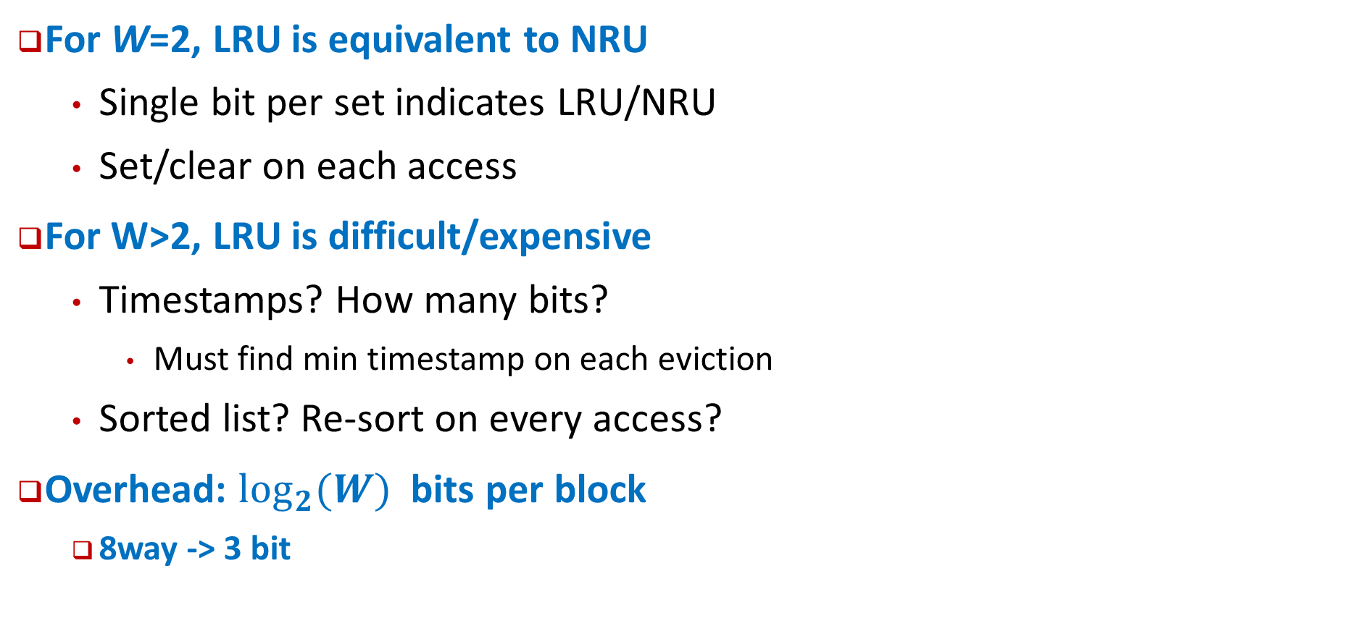
Least-Recently Used
For W=2, LRU is equivalent to NRU
Single bit per set indicates LRU/NRU
Set/clear on each access
For W>2, LRU is difficult/expensive
Timestamps? How many bits?
Must find min timestamp on each eviction
Sorted list? Re-sort on every access?
Overhead: $\log_{2}(W)$ bits per block
8way -> 3 bit

Slide 7
LRU
Notes:
وقتی میزان انجمنی زیاد میشود، پیچیدگی LRU زیاد میشود. این همه شمارنده و بحث جستجو و ... زمان میبرد

Slide 8
Pseudo-LRU
Notes:
به ازای n بلوک در یک ست، n-1 بیت لازم داریم.

Slide 9
Pseudo-LRU
b
b
b
Pseudo
−
LRU
−
replace
:
(
used
in
Intel
80486)
0
1
2
if
b
b
=
00
then
replace
Line
0
;
0
1
0
1
if
b
b
=
01
then
replace
Line
1
;
0
1
Mux
if
b
b
=
10
then
replace
Line
2
;
0
2
if
b
b
=
11
then
replace
Line
3
;
0
2
Line
number

Slide 10
Practical Pseudo-LRU
0
J
Older
1
F
1
C
0
B
1
X
0
Y
Newer
1
A
Rather than true LRU, use binary tree
Each node records which half is older/newer
Update nodes on each reference
Follow older pointers to find pseudo-LRU victim
Z

Slide 11







Practical Pseudo-LRU In Action
J
Y
X
Z
B
C
F
A
$$b_{3}$$
J
$$b_{1}$$
F
011: PLRU Block B is here
C
$$b_{4}$$
$$b_{0}$$
B
$$b_{5}$$
X
110: MRU block is here
$$b_{2}$$
Y
A
$$b_{6}$$
Z

Slide 12
Practical Pseudo-LRU
Refs: J,Y,X,Z,B,C,F,A
0
J
Older
1
F
011: PLRU Block B is here
1
C
0
B
1
X
110: MRU block is here
0
Y
Newer
1
A
Z
Each access: flip nodes along path to block
Eviction: follow LRU path
Overhead: (W-1)/W bits per block

Slide 13
True LRU Shortcomings
Streaming data/scans: x₀, x₁, …, x_{n}
Effectively no temporal reuse
Thrashing: reuse distance > W
Temporal reuse exists but LRU fails
For n>W no blocks remain after scan/thrash
Incur many conflict misses after scan ends
Pseudo-LRU sometimes helps a little bit

Slide 14
LIP (LRU Insertion Policy)
Is a simplified variant of protected LRU
Qureshi et al. ISCA 2007
Insert new blocks into filter part
Here Filter list of size 1, reuse list of size (W-1)
Do this adaptively: Use set dueling to decide LIP vs. LRU
1 (or a few) set uses LIP vs. 1 that uses LRU
Compare hit rate for sets
Set policy for all other sets to match best set
Notes:
دو تا نو آوری دارند
1- بلوک جدید را بذاریم ته صف
2- اینکه LIP باشد یا LRU تعدادی ست را بعنوان مرجع درنظر میگیریم. مثلاً 32 تا با LRU و 32 تا با LIP.
در لحظه میبینیم که Miss rate کدام کمتر است.

Slide 15
Not Recently Used (NRU)
Keep NRU state in 1 bit/block
Bit is set to 1 when installed (assume reuse)
Bit is set to 0 when referenced (reuse observed)
Evictions favor NRU=1 blocks
If all blocks are NRU=0
Eviction forces all blocks in set to NRU=1
Picks one as victim (can be pseudo-random, or rotating, or fixed left-to-right)
Provides some scan and thrash resistance
Relies on “randomizing” evictions rather than strict LRU order
Used by Intel Itanium, Sparc T2

Slide 16
Least Frequently Used
Counter per block, incremented on reference
Evictions choose lowest count
Logic not trivial (W² comparison/sort)
Storage overhead
1 bit per block → like NRU
How many bits are helpful?
Notes:
دخیل نکردن زمان در این الگوریتم، باعث میشود این الگوریتم یک الگوریتم نا عادلانه باشد

